Slide 1
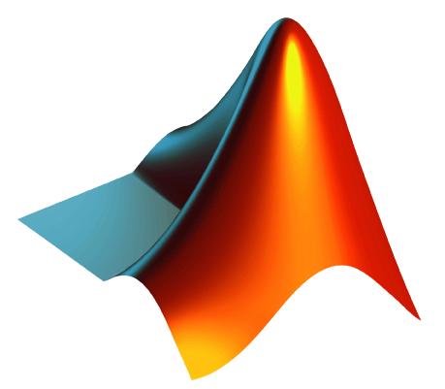
MATLAB

Slide 2
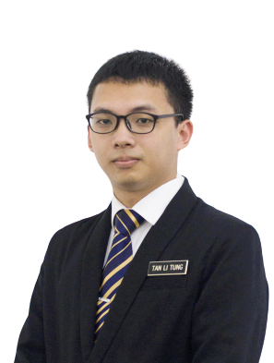


ABOUT ME
Third year Electrical & Electronics Engineering student from Universiti Teknologi PETRONAS (UTP).
Minor in Big Data Analytics.
Performed various tasks using MATLAB in different fields like signal processing, artificial intelligence, face recognition, etc.
tanlitung.github.io
linkedin.com/in/tanlitung

Slide 3
WHAT DO YOU SEE & HEAR IN YOUR UNIVERSITY?
PhD (Dr)
Big Data
Ir
Machine Learning
IR 4.0
Signal Processing
Face Recognition
Engineering Team Project
Final Year Project

Slide 4
THE QUESTION IS
Can a student like us, use all these technologies?

Slide 5
THE ANSWER IS
YES

Slide 6
GOAL FOR TODAY
We will together experience how all these technologies looks like in MATLAB

Slide 7
OVERVIEW
Introduction to MATLAB
Applications of MATLAB
Hands-on MATLAB Activities
Questions and Answer

Slide 8
WHAT IS MATLAB?
MATLAB® (Matrix Laboratory) is a programming platform designed specifically for engineers and scientists.
Written in Fortran in the late 1970s by Cleve Moler, it was a simple interactive matrix calculator.
In 1983, Jack Little, who was an engineer, visited Moler for MATLAB. He sees the commercial potential in MATLAB, so Jack Little joined hands with Steve Bangert and Moler to rewrite MATLAB in C Language.
This was also accompanied with the formation of MathWorks in the year 1984 to further enhance the development of MATLAB.

Slide 9


HISTORY OF MATLAB
1970s
Cleve Moler

Slide 10




HISTORY OF MATLAB
1983 - 1984
Cleve Moler
Jack Little
Steve Bangert

Slide 11
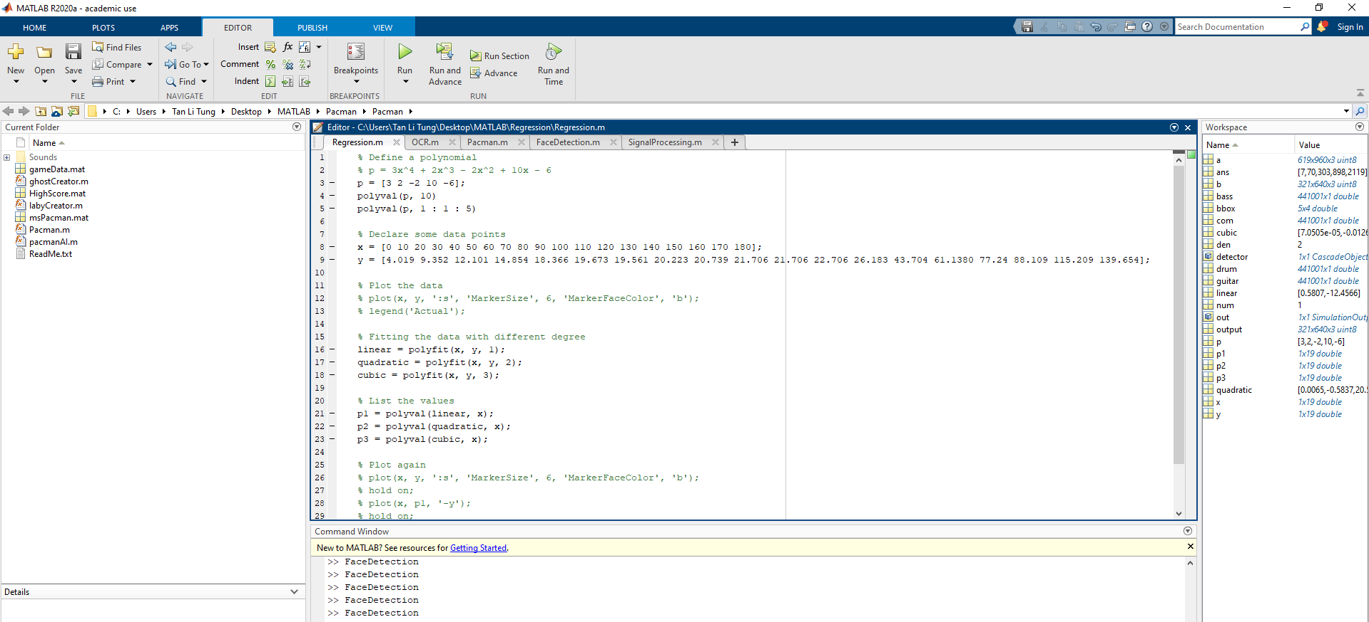
WHY USE MATLAB?
Easy and intuitive.

Slide 12
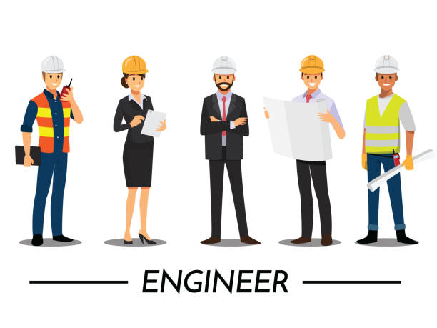
WHY USE MATLAB?
Designed for Engineers and Scientist.

Slide 13
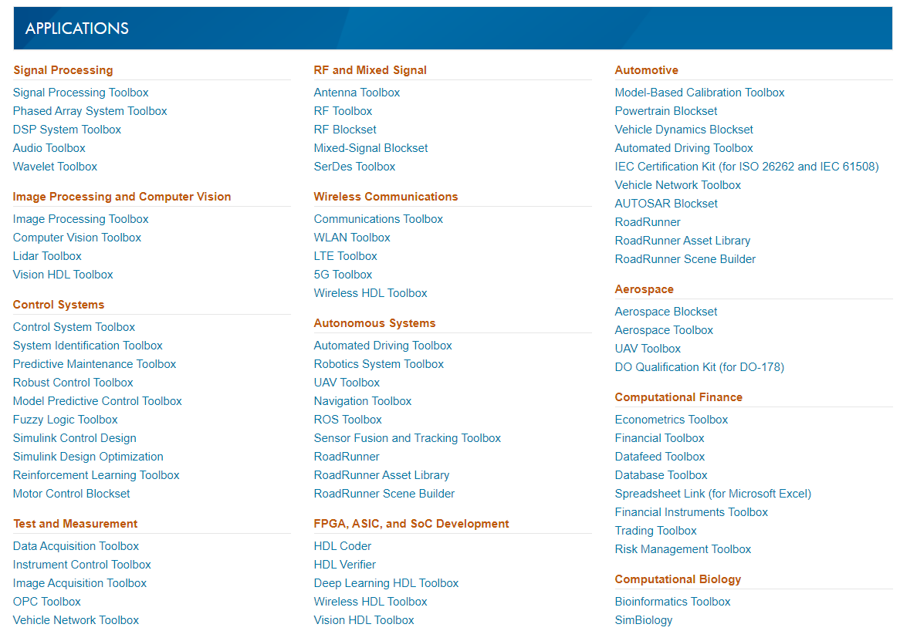
WHY USE MATLAB?
Lots of Toolboxes available (Lots of resources).
More at:
https://www.mathworks.com/products/index.html?s_tid=hp_fp_viewall

Slide 14
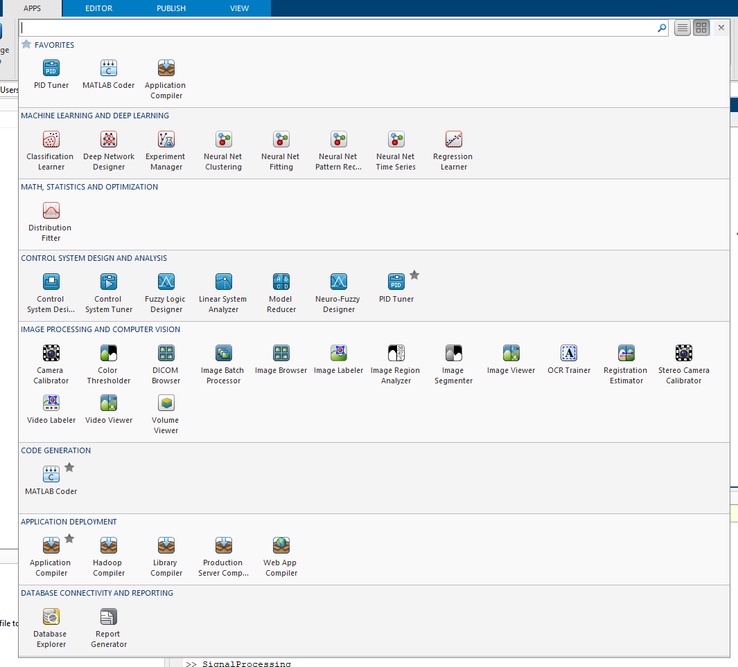
WHY USE MATLAB?
MATLAB App (No need to code!).

Slide 15
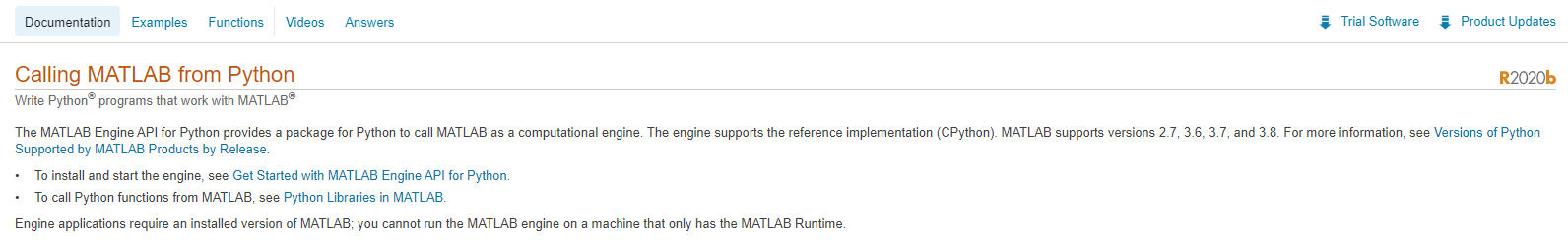
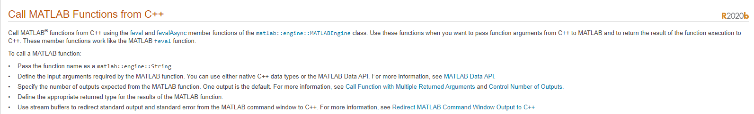
WHY USE MATLAB?
MATLAB integrates workflow. Fast. Reliable.

Slide 16
APPLICATIONS
Matrix calculations.
Plots of graphs.
Machine learning.
Signal processing.
Face recognition.
Optical Character Recognition (OCR).
And many more……

Slide 17
HANDS-ON

Slide 18
MACHINE LEARNING

Slide 19
Predict Future Values From Current Trends
1 | 2 | 3 | 4
3 | 5 | 7 | z
What should z be?
Trend: 2x + 1
Z = 2(4) + 1 = 9

Slide 20
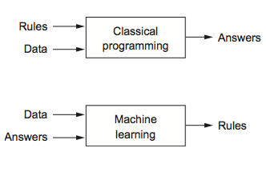

Slide 21
id | name | host_id | host_name | neighbourhood_group | neighbourhood | latitude | longitude | room_type | price | minimum_nights | number_of_reviews | last_review | reviews_per_month | calculated_host_listings_count | availability_365
2539 | Clean & quiet apt home by the park | 2787 | John | Brooklyn | Kensington | 40.64749 | -73.9724 | Private room | 149 | 1 | 9 | 19/10/2018 | 0.21 | 6 | 365
2595 | Skylit Midtown Castle | 2845 | Jennifer | Manhattan | Midtown | 40.75362 | -73.9838 | Entire home/apt | 225 | 1 | 45 | 21/5/2019 | 0.38 | 2 | 355
3647 | THE VILLAGE OF HARLEM....NEW YORK ! | 4632 | Elisabeth | Manhattan | Harlem | 40.80902 | -73.9419 | Private room | 150 | 3 | 0 |  |  | 1 | 365
3831 | Cozy Entire Floor of Brownstone | 4869 | LisaRoxanne | Brooklyn | Clinton Hill | 40.68514 | -73.9598 | Entire home/apt | 89 | 1 | 270 | 5/7/2019 | 4.64 | 1 | 194
5022 | Entire Apt: Spacious Studio/Loft by central park | 7192 | Laura | Manhattan | East Harlem | 40.79851 | -73.944 | Entire home/apt | 80 | 10 | 9 | 19/11/2018 | 0.1 | 1 | 0
5099 | Large Cozy 1 BR Apartment In Midtown East | 7322 | Chris | Manhattan | Murray Hill | 40.74767 | -73.975 | Entire home/apt | 200 | 3 | 74 | 22/6/2019 | 0.59 | 1 | 129
5121 | BlissArtsSpace! | 7356 | Garon | Brooklyn | Bedford-Stuyvesant | 40.68688 | -73.956 | Private room | 60 | 45 | 49 | 5/10/2017 | 0.4 | 1 | 0
5178 | Large Furnished Room Near B'way | 8967 | Shunichi | Manhattan | Hell's Kitchen | 40.76489 | -73.9849 | Private room | 79 | 2 | 430 | 24/6/2019 | 3.47 | 1 | 220
5203 | Cozy Clean Guest Room - Family Apt | 7490 | MaryEllen | Manhattan | Upper West Side | 40.80178 | -73.9672 | Private room | 79 | 2 | 118 | 21/7/2017 | 0.99 | 1 | 0
5238 | Cute & Cozy Lower East Side 1 bdrm | 7549 | Ben | Manhattan | Chinatown | 40.71344 | -73.9904 | Entire home/apt | 150 | 1 | 160 | 9/6/2019 | 1.33 | 4 | 188
5295 | Beautiful 1br on Upper West Side | 7702 | Lena | Manhattan | Upper West Side | 40.80316 | -73.9655 | Entire home/apt | 135 | 5 | 53 | 22/6/2019 | 0.43 | 1 | 6

Slide 22
Optical Character Recognition (OCR)

Slide 23
MATLAB GRAPHIC USER INTERFACE (GUI)

Slide 24
FACE DETECTION

Slide 25
SIGNAL PROCESSING

Slide 26
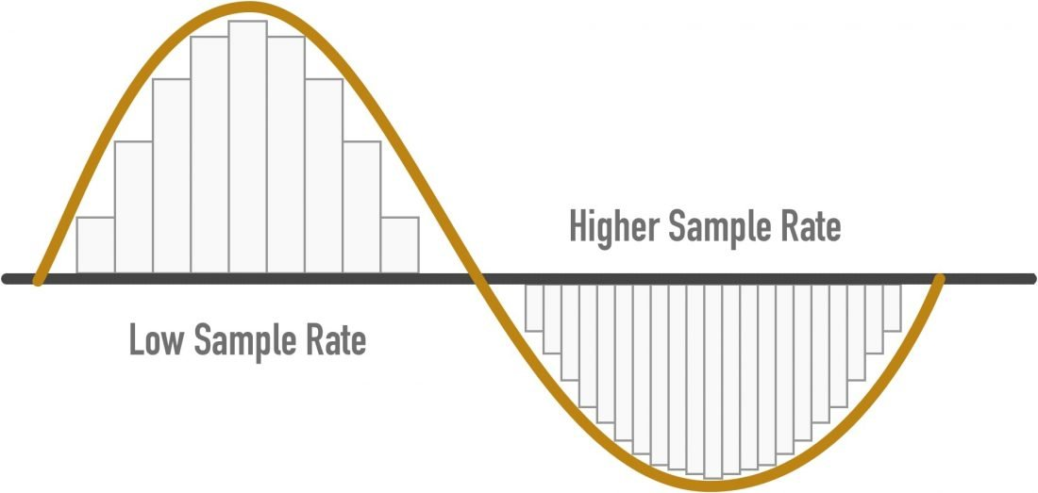

Slide 27
USEFUL LINKS
MATLAB Academy (Certification)
https://matlabacademy.mathworks.com
MATLAB for Beginners
https://www.youtube.com/watch?v=T_ekAD7U-wU
MATLAB Drive
https://www.mathworks.com/products/matlab-drive.html
Solving ODEs in MATLAB
https://www.mathworks.com/help/symbolic/solve-a-single-differential-equation.html

Slide 28
THANK YOU

